Slide 1

HUAC 9000 Pitch
Conor Barry-Hoke
5 September 2018

Slide 2
[GROUP NAME] [GROUP TAGLINE]
YOU are a totally legitimate campaign strategy group
YOU NEED to expand your voter turnout for your voters
YOU KNOW the negative impact of a misplaced ad
So where are these voters?? How do you mine them and find them without stepping on mines?

Slide 3

Introducing The HUAC 9000
Named for the infamous and highly successful communist hunting committee of the 1950s
HUAC 9000 uses data from thousands of known Democratic and Republican posts to ferret out party-line sentiment hidden under benign cat pictures

Slide 4

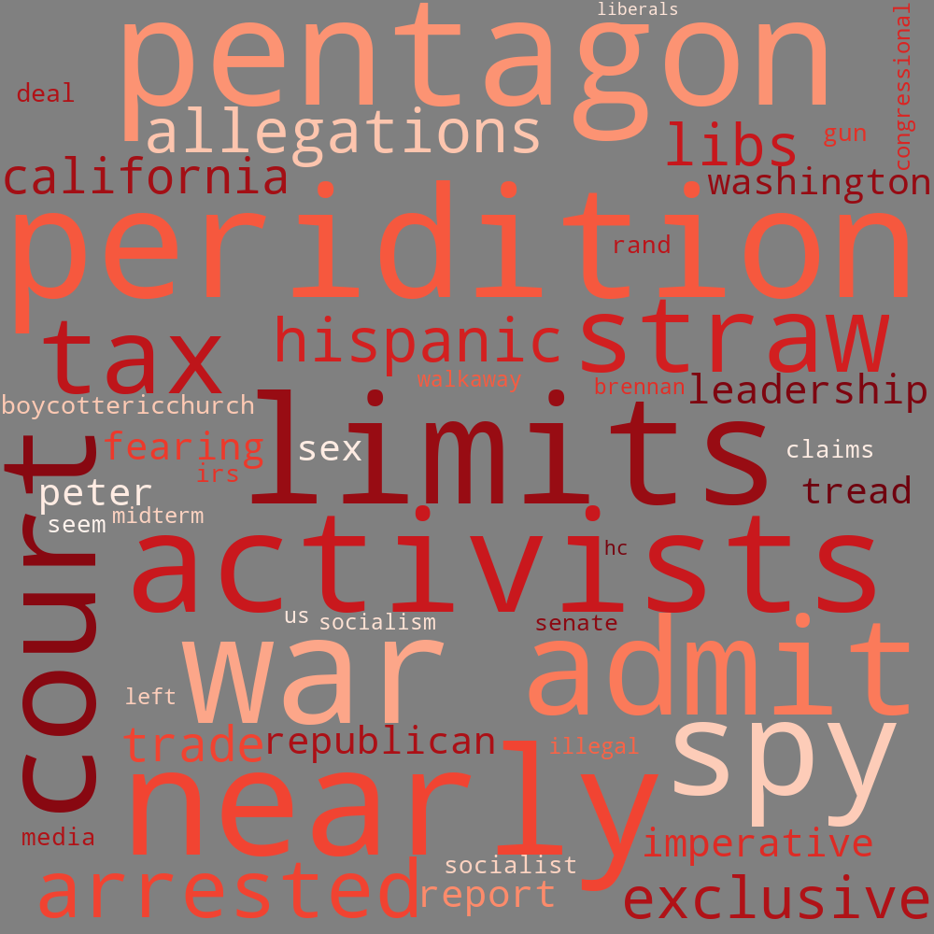
Introducing The HUAC 9000
The HUAC 9000 analyzed thousands of reddit posts to find out what Democrats and Republicans are talking about:

Slide 5
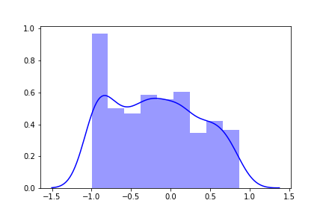
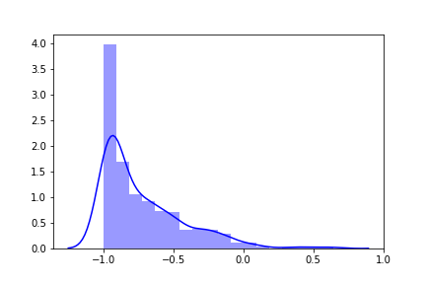
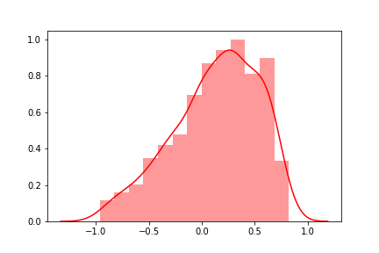
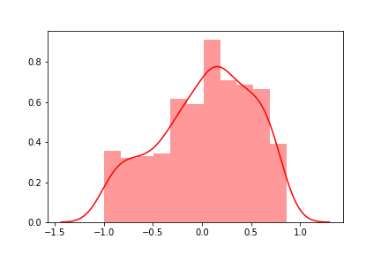
Introducing The HUAC 9000
The HUAC 9000 can identify party leanings saving you time and precious resources by increasing the effectiveness of ads
TheDonald: Obsessed with what the Democrats are up to
Dog people: Hardcore Democrats
College Football Fans: Republican
Communists – talking about the things Republicans are afraid of
Color in the charts above shows whether subreddit was identified as Republican or Democrat
Distributions are of total posts identified Dem / Rep – score less than 0 indicates Democrat

Slide 6
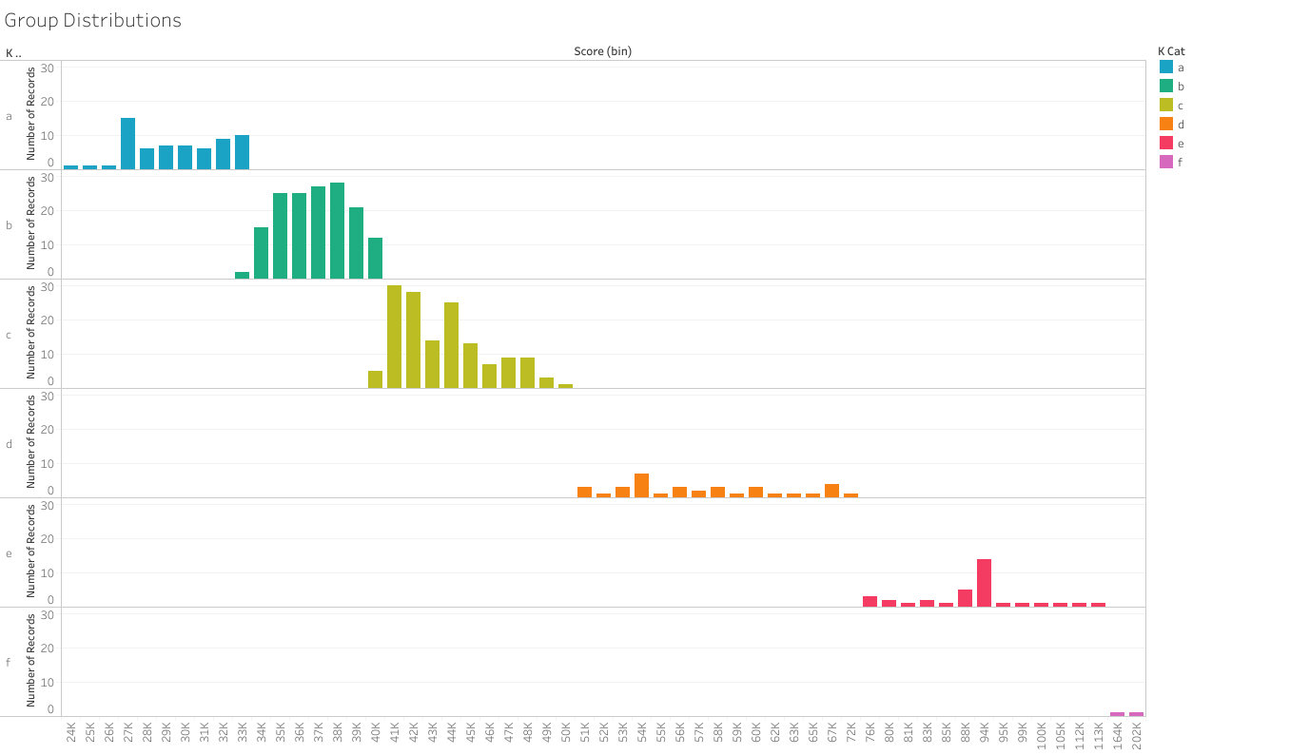
We can do it
Our team:
Years of cumulative experience getting blind-sided by uncomfortable political conversations that seem to erupt out of nowhere
Outperforming cohorts in Kaggle competitions
HUAC 900
All Data Science Average

Slide 7
Now is the Time
Our team of trained experts will stand up a HUAC 9000 implementation including
Pre-Tuning to your candidate and issues in your state
Instruction in teaching you to search Reddit to find your supporters.
No one is looking over your shoulder
If they can vote for Laurel or Yonny, they can vote for your candidate. Don't let them get away - buy HUAC 9000 Today.

Slide 8
END

